Slide 1
LIGHTUP
Multiplayer Draw-and-Guess Game

Slide 2
Team members
PHAM Gia Phuc - BI10-138
PHAM Duc Thang - BI10-159
DANG Gia Linh - BI10-101
TRAN Dac Minh - BI10-113
DO Hoang Quan - BI10-147

Slide 3
Information and communication technology
Digital Game
First appeared in 1962
Sales of 134.9 billion dollars in 2018
Casual game
Any type of gameplay, genre
Simpler rules, shorter session, less learned skills
No expect familiar with mechanics, controls, tropes

Slide 4
Motivation
For fun
To make new friends easier
To relax
To learn new English words

Slide 5
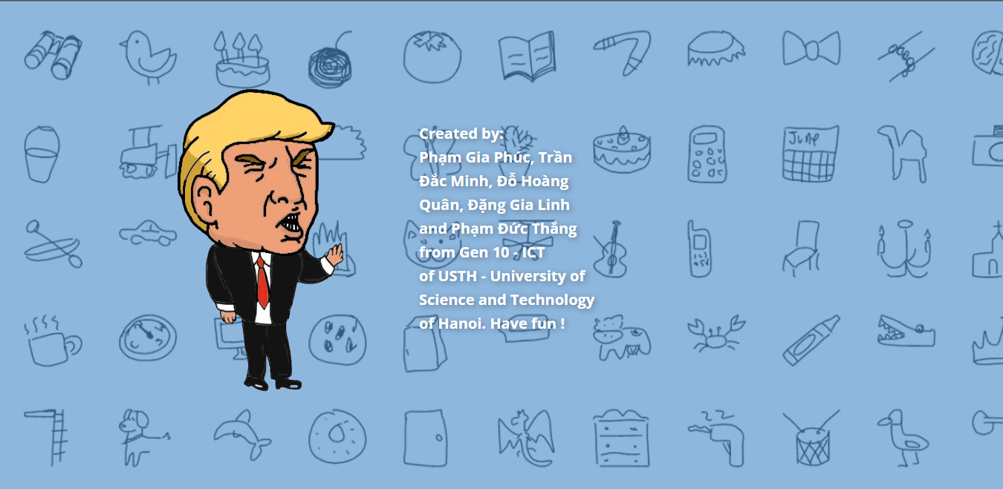
LightUp
What is LightUp
Multiplayer web game
choose a word
make a drawing
Be creative !
no download or installation
various fascinating characters
capability to add a new list of words
guess the idea
Notes:
LightUp is a multiplayer web game where ….

Slide 6
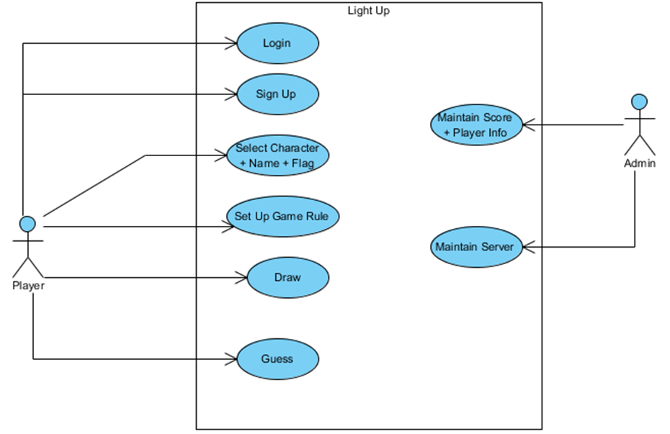
Analysis Design
Use case
The Use case diagram shows how a player can interact with the game

Slide 7
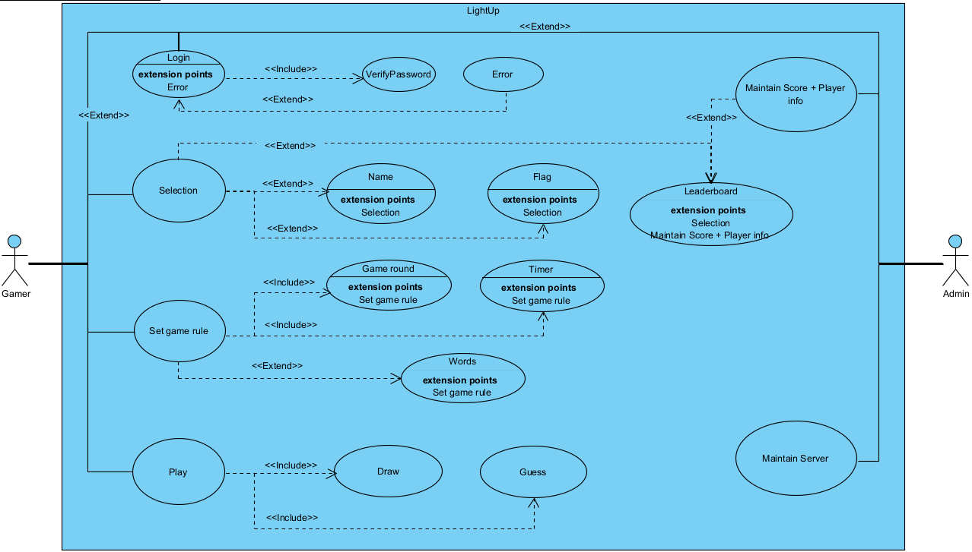

Slide 8
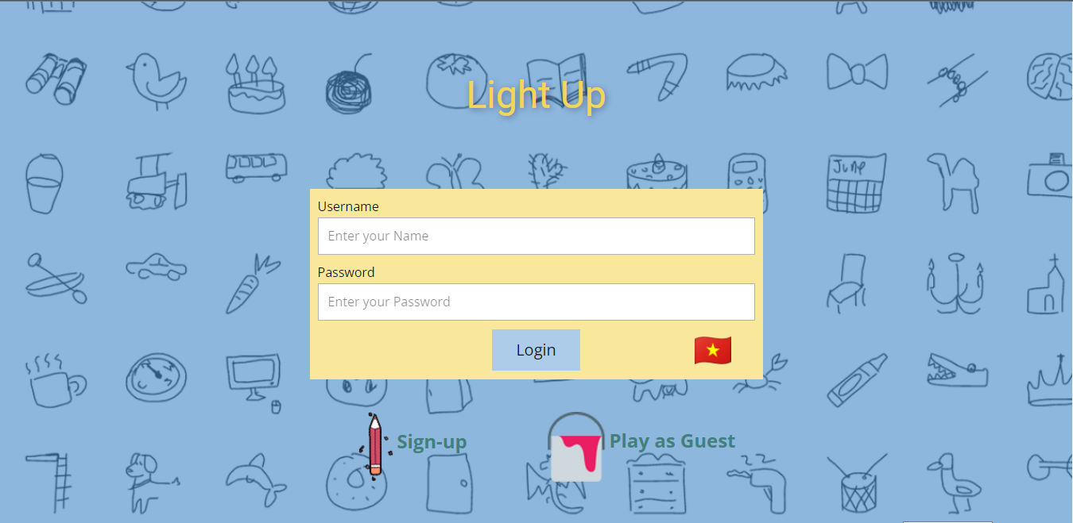
Login
3 options:
to login
Sign-up
play as guest.

Slide 9
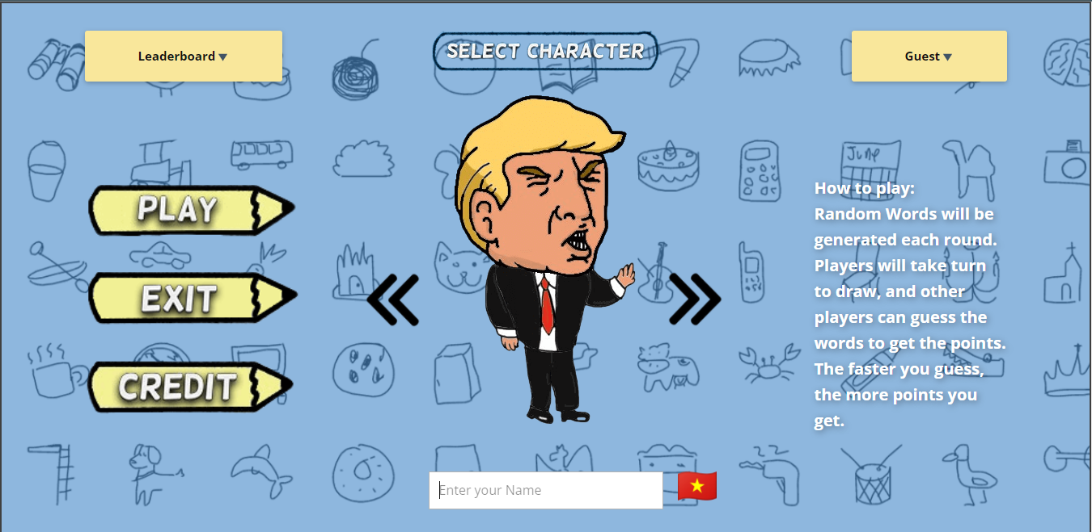
Customize Character
input nickname
choose character (avatar)
choose national flag
name left blank: a random name will be generated

Slide 10
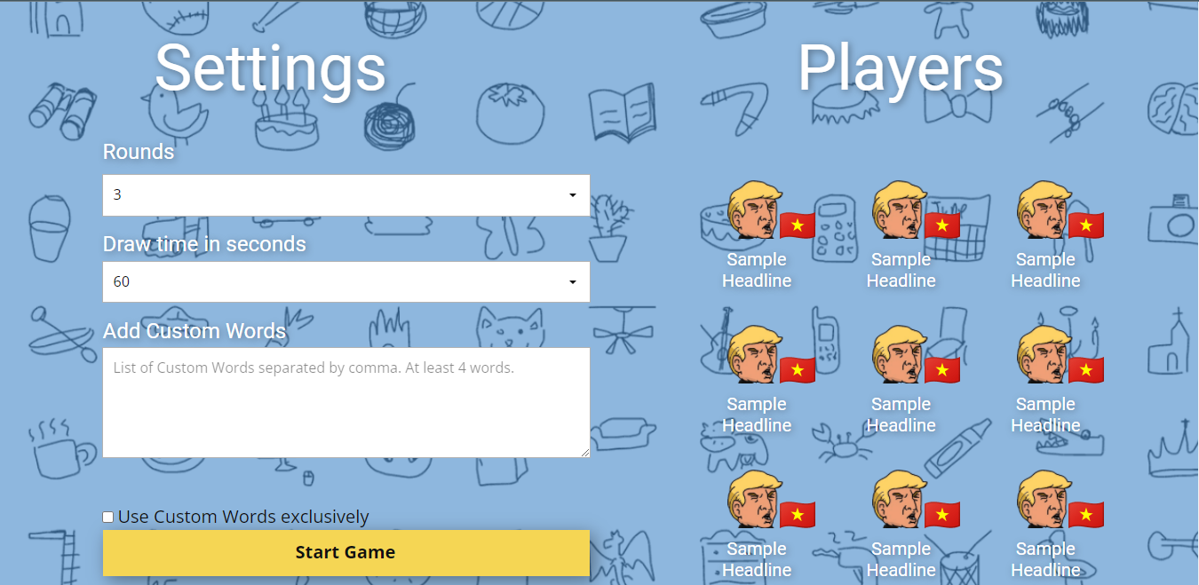
Game setting
First player in the room
set up game rules
start the game.
The game rules contains:
number of rounds,
drawing time limit
custom words

Slide 11
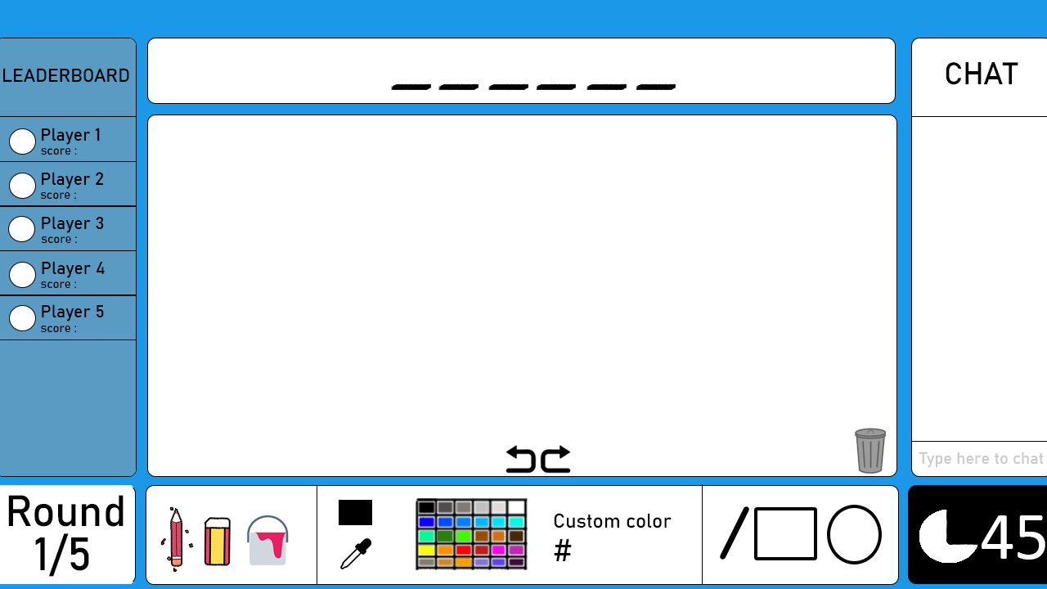
Gaming room
one player will be chosen to draw
others will guess the word
round end if:
all player have guessed the word
or the time runs out
Who get the word wins

Slide 12
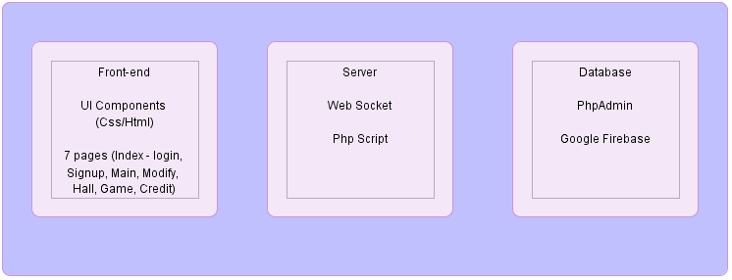
System architecture
The game consists of
The front-end: 7 pages created by HTML and CSS
The server side: PHP script and WebSocket
The database: includes static database and realtime database
Notes:
Ques about Static db vs realtime db

Slide 13
Front-end
7 Pages:
Login
Sign Up
Main
Credit
Responsive web pages.
Modify
Hall
Game

Slide 14
Server Side
Firebase Realtime Database: connect between clients.
Php scripts: transmit the data between the client and the static database.
PhpAdmin and Firebase Console (provided by Google): allow game manager to keep track of data.
Notes:
Phần gạch chân chỉ để nói, khi nào hoàn thành script thuyết trình rồi sẽ phải xóa đi trên slide.

Slide 15
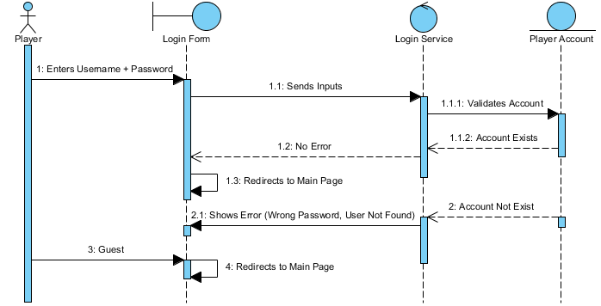
Database (Static Database)
Static Database (SQL) contains the player account information which will be used when initialize the web pages and to provide services like login, sign up and modify.
After the game has ended there will also be a query to update the Player Scores Information.
Player account information includes : ID, Username, Password, Nation
TotalScore and HighestScore.
Notes:
Nhét db design thay cái slide này

Slide 16
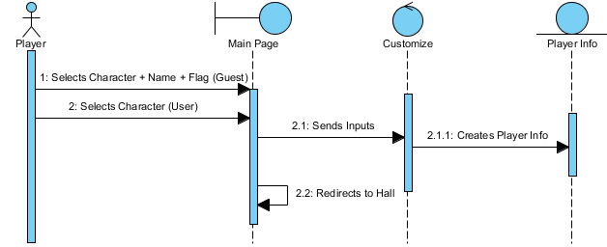
Database (Realtime Database)
Realtime Database (Firebase) will store data (in JSON format) of the on-going game which includes:
The Players: Order, Nickname, Avatar, Flag, Score
The Game Rules: Rounds number, Time limit, Custom words
The Round: Current Time, The Word, The Hint, The Drawer (Player Order)
The Canvas: Draw Lines (drawable using canvas)
Draw History: Canvas Image Url (for the undo function)
The Chat: Chat Messages
Guessed: Player Order List ([1,2,3,....,9])
Notes:
Database design here

Slide 17
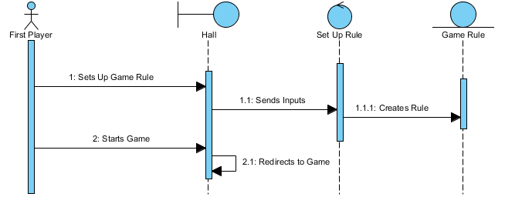

Slide 18
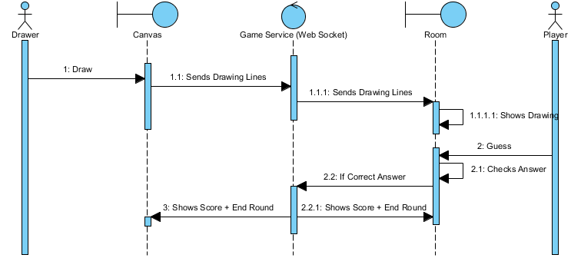

Slide 19
Implementation
How we build the game
Front-end
Server Side
Database

Slide 20
Front-end
CSS: pages layouts.
Images & Icons: self-designed and drawn.
Grid Layout and Grid Repeater: display pages and UI components.
Javascript: functionalities (ie: redirecting, changing images, drawing on canvas,...).
Notes:
Phần gạch chân chỉ để nói, khi nào hoàn thành script thuyết trình rồi sẽ phải xóa đi trên slide.

Slide 21
Server Side
PHP: send data from server to client and vice versa.
MySQL: provides an object
Firebase Realtime Database: send data to all clients at the same time.

Slide 22
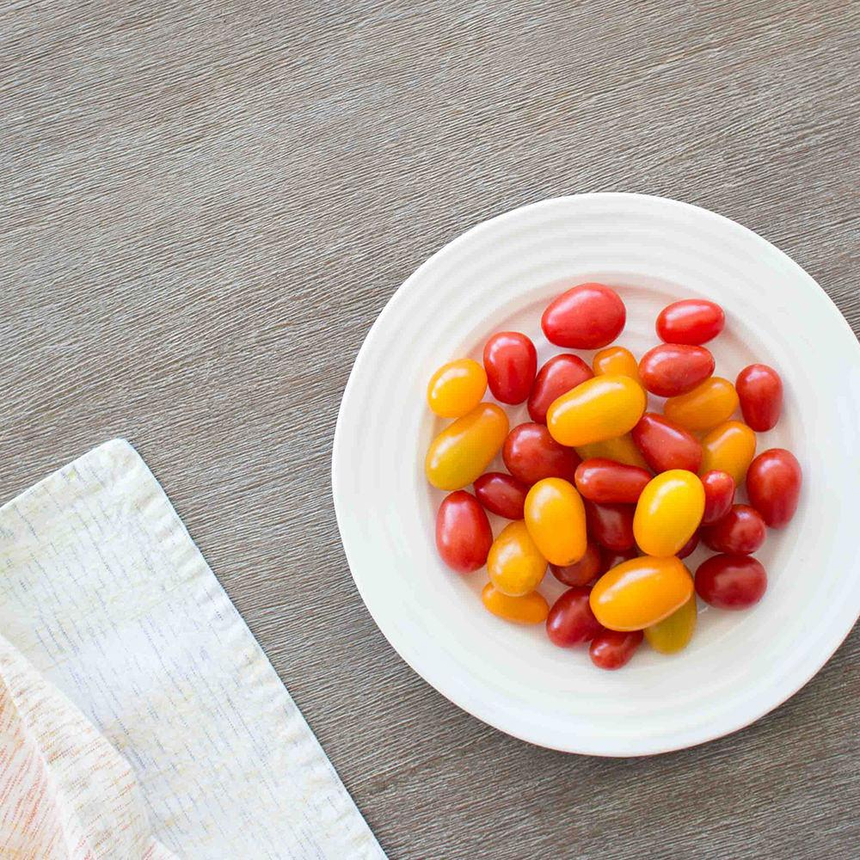
GAMING
TIME

Slide 23
Conclusion
The Game is incompleted for now
The Game has high potential to achieve its purpose *
The Game still have many things to improve
Notes:
* ‘which is to bring relaxing time to people and maybe help players learn new English words’

Slide 24
Thanks
Whoa! That’s a big number, aren’t you proud?
Notes:
End of slides, estimated time: Intro 2’ + Use case 5’ + Architecture 2’ + Implementation 3’ + Demo ?? ← No one cares about the product (~ 2’) + Conclusion 1’ = 15’ -17’ ← Tight timeline, must be quick

